Slide 1

Notes and assignment sharing system
( A Cloud based application)​

Slide 2
Introduction
In this project, student and faculty can upload/download engineering subject notes. Users can also edit the notes uploaded by him.
However the users (except administrator), do not have authority , to delete the records of the website.
It is also secure and easy to use process, considering the demands of multimedia notes.

Slide 3
Objectives
To reduce manual paperwork.
Reduced sharing and distribution time.
Increased reliability.
Increased operational efficiency.
Security.

Slide 4
Features
Common sharing platform
Time Saving
Great Boost
Multi user System
User friendly
Memory Utilization

Slide 5
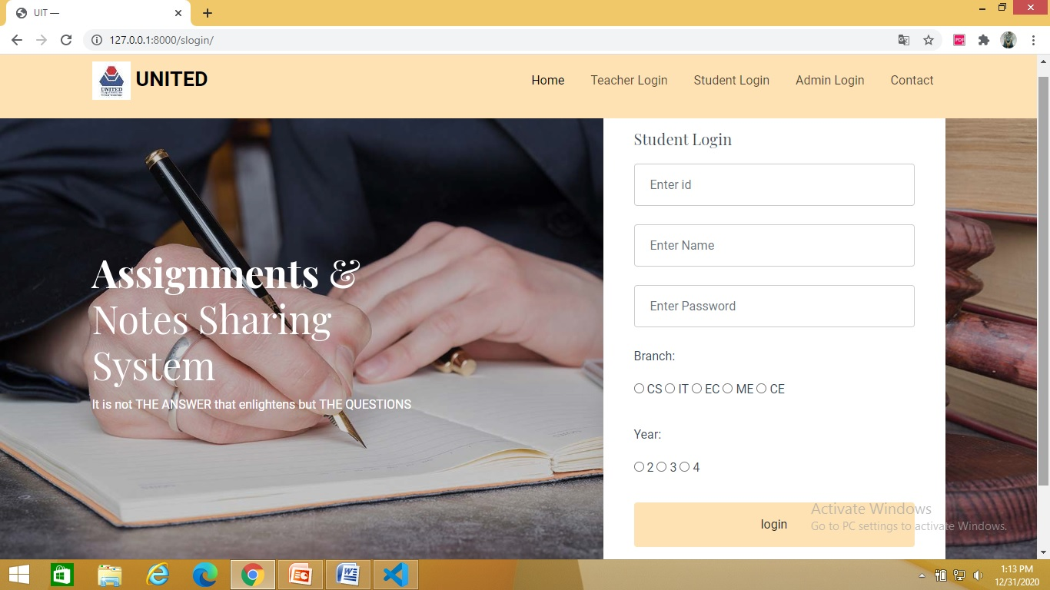
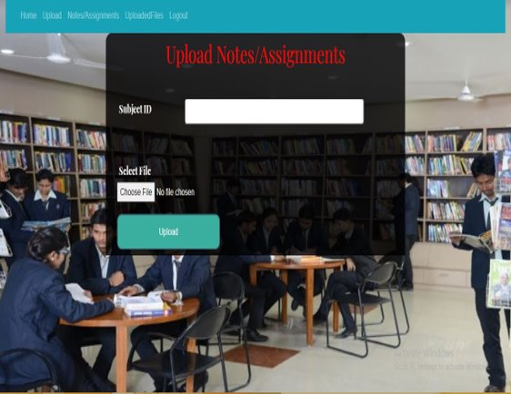
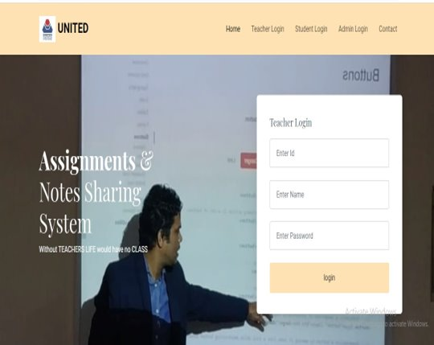
Modules
Student
Faculty
Admin

Slide 6
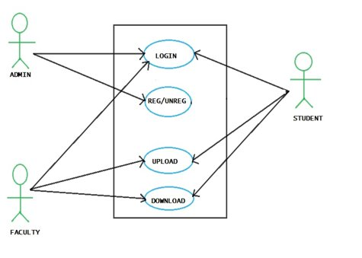
Use Case Diagram

Slide 7
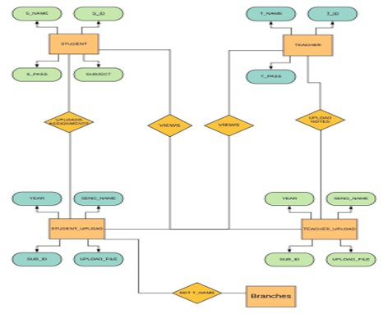
ER-Diagram

Slide 8
Conclusion
The project acts as an aid to teachers and students for assigning different assignments and notes.
The pdf section contains a data dictionary that helps the student find the appropriate meaning to the word.

Slide 9

Your Queries are welcome!!
Presented by:-​
Varad Nair​
Utkarsh Malviya​
Safalata Singh​

